Slide 1
Introduction to Programming Language II(Java)
Fariha Zahin

Slide 2
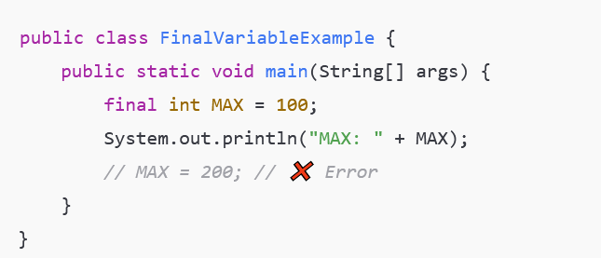
final keyword
final keyword is used to restrict the user in Java. It can be applied to:
Variables – to make them constant (immutable)
Methods – to prevent overriding
Classes – to prevent inheritance
final Variable :
final variable is constant; its value cannot be
reassigned.
It must be initialized at declaration o
constructor (if not static).
Declares a constant variable MAX. Attempting to
reassign it will cause a compile-time error.

Slide 3
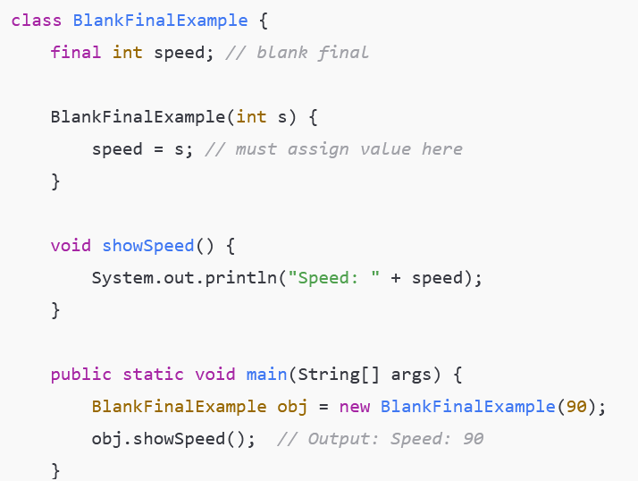
Blank Final Variable
A blank final variable is a final variable declared without initialization.
It must be initialized only once, typically in the constructor.
speed variable is declared but not initialized immediately. It's initialized once inside the constructor. Useful when the value depends on runtime input.

Slide 4
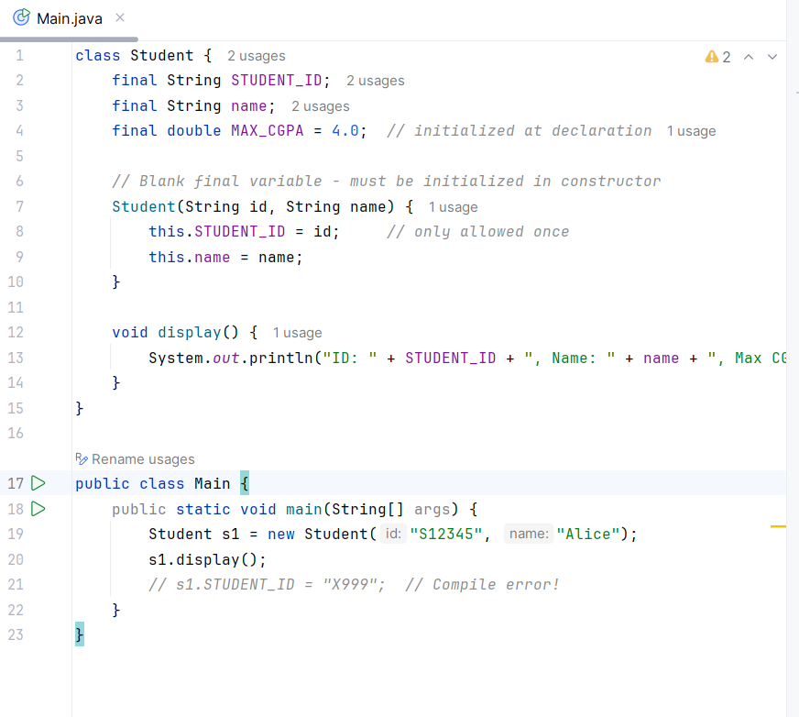
Blank Final Variable
A blank final variable is a final variable declared without initialization.
It must be initialized only once, typically in the constructor.

Slide 5
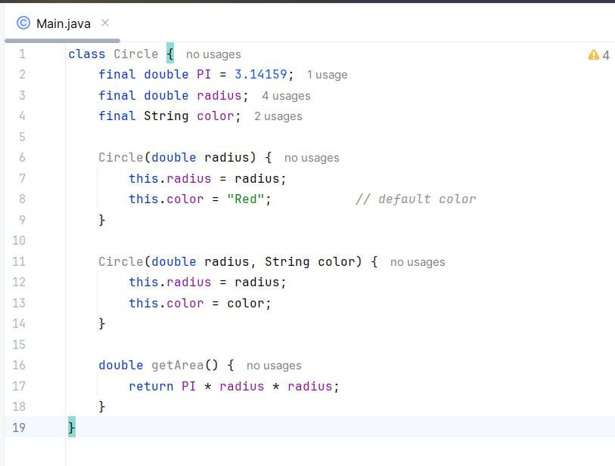
Blank Final Variable
A blank final variable is a final variable declared without initialization.
It must be initialized only once, typically in the constructor.

Slide 6
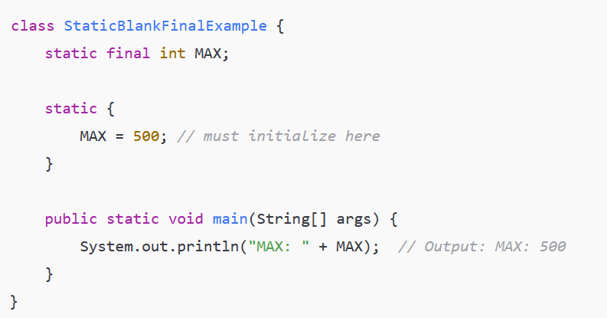
Static Blank Final Variable
A static blank final is a static final variable declared without a value.
It must be initialized once in a static block (not constructor).
A class-level final variable that's assigned in a static block. It's initialized once when the class is loaded, not per object.

Slide 7
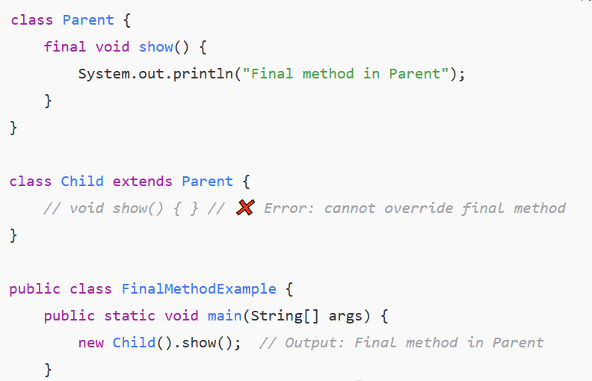
Final Method
A final method cannot be overridden by subclasses.
The method show() in the Parent class is marked as final, so the subclass Child cannot override it. This is used to protect method logic from being altered.

Slide 8
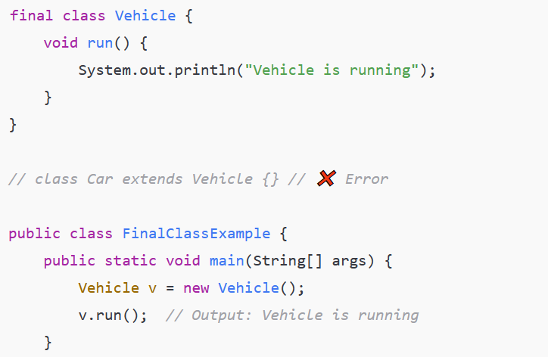
Final Class
A final class cannot be extended/inherited.
The class Vehicle is declared as final, so no other class can extend it. This is commonly used for utility or security-sensitive classes

